Slide 1


Slide 2

School Orientation –Bus Presentation
Thank you for the opportunity to meet with you today and to present to you information in relation to bus travel in the region. Please do not hesitate to ask questions.
All Children wishing to travel on a Sapphire Coast Buslines bus MUST complete a Rural and Regional online application and return it to the school as soon as possible. You can complete these online applications from
Term 4, 2016 for travel in 2017.
Notes:
Introduce yourself and your position at the company and ask for questions to be held till the end.

Slide 3

Who is eligible for free travel?
All Children in Kindergarten – Year 2 are eligible for School Free Bus Travel no matter how close to the school they live. An online application is required to be completed.
Children in Year 3 – Year 12 are also eligible for school free bus travel assuming the following guidelines:
  Year 3 – Year 6: you must live outside a radial distance of 1.6 km from the school or 2.3km walking distance
  Year 7 – Year 12: you must live outside a radial distance of 2.0 km from the school or 2.9km walking distance
  Children within these distances may still be eligible to apply on safety or medical grounds.
  If your child requires travel to different parental addresses you must compete two online application forms.
Notes:
Safety and Medical can be applied by filling out a form that we have at the office or can post out.
Explain that joint custody situations have two addresses on the pass. We require a form for each parent. If there is a ‘case document’ to support the joint custody then we need a copy of that or otherwise Stat Dec’s. It will normally only be awarded in the case of 50/50 share arrangements but is best to speak to TfNSW.

Slide 4
When Do you need to complete and online application form?
You must also complete a new online application if the following applies to your child:
  Starting at school (Kindergarten)
  Moving schools
  Moving address
  Progressing from Year 2 into Year 3 or from Year 6 into Year 7 (even if it is at the same school).

Slide 5
How to apply for student travel online?
Access the Transport for NSW website
School Students Transport Scheme tab (bottom right hand side)
SSTS for students, parents and guardians
Rural & Regional applications online
Add your details
Remember to print, sign and return this application to your school for verification (THIS IS CRITICAL FOR YOUR APPLICATION TO PROGRESS)
The school will then forward for your application to the Ministry
Once approved, a bus pass will be printed and distributed by Sapphire Coast Buslines
If you are unable to access the web or have difficulty in completing this online application please contact Transport for NSW on 131500

Slide 6
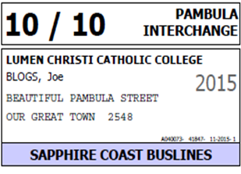
How will I know which bus my child catches
Call our office for bus times and bus numbers on 64 95 6452.
The Bus number your child catches in the morning, will be printed on their pass.
There is also some information in relation to bus travel on our website: www.scbuslines.com.au
The pass looks like this:

Slide 7
Behavior on Buses
We do not tolerate bullying on our school buses.
If your child is having any trouble on the bus please report it to driver straight away, please also feel free to call the office to discuss your concerns.
The pass is a privilege not a right. Each child who holds a pass has agreed to follow the code of conduct and any breaches of this code are treated very seriously.
If you are concerned about your child's first few journey’s to school we are more than happy for you to travel for free on the bus with the child – please call to arrange.
For more information on the code of conduct visit http://www.transport.nsw.gov.au/content/student-conduct-when-travelling

Slide 8
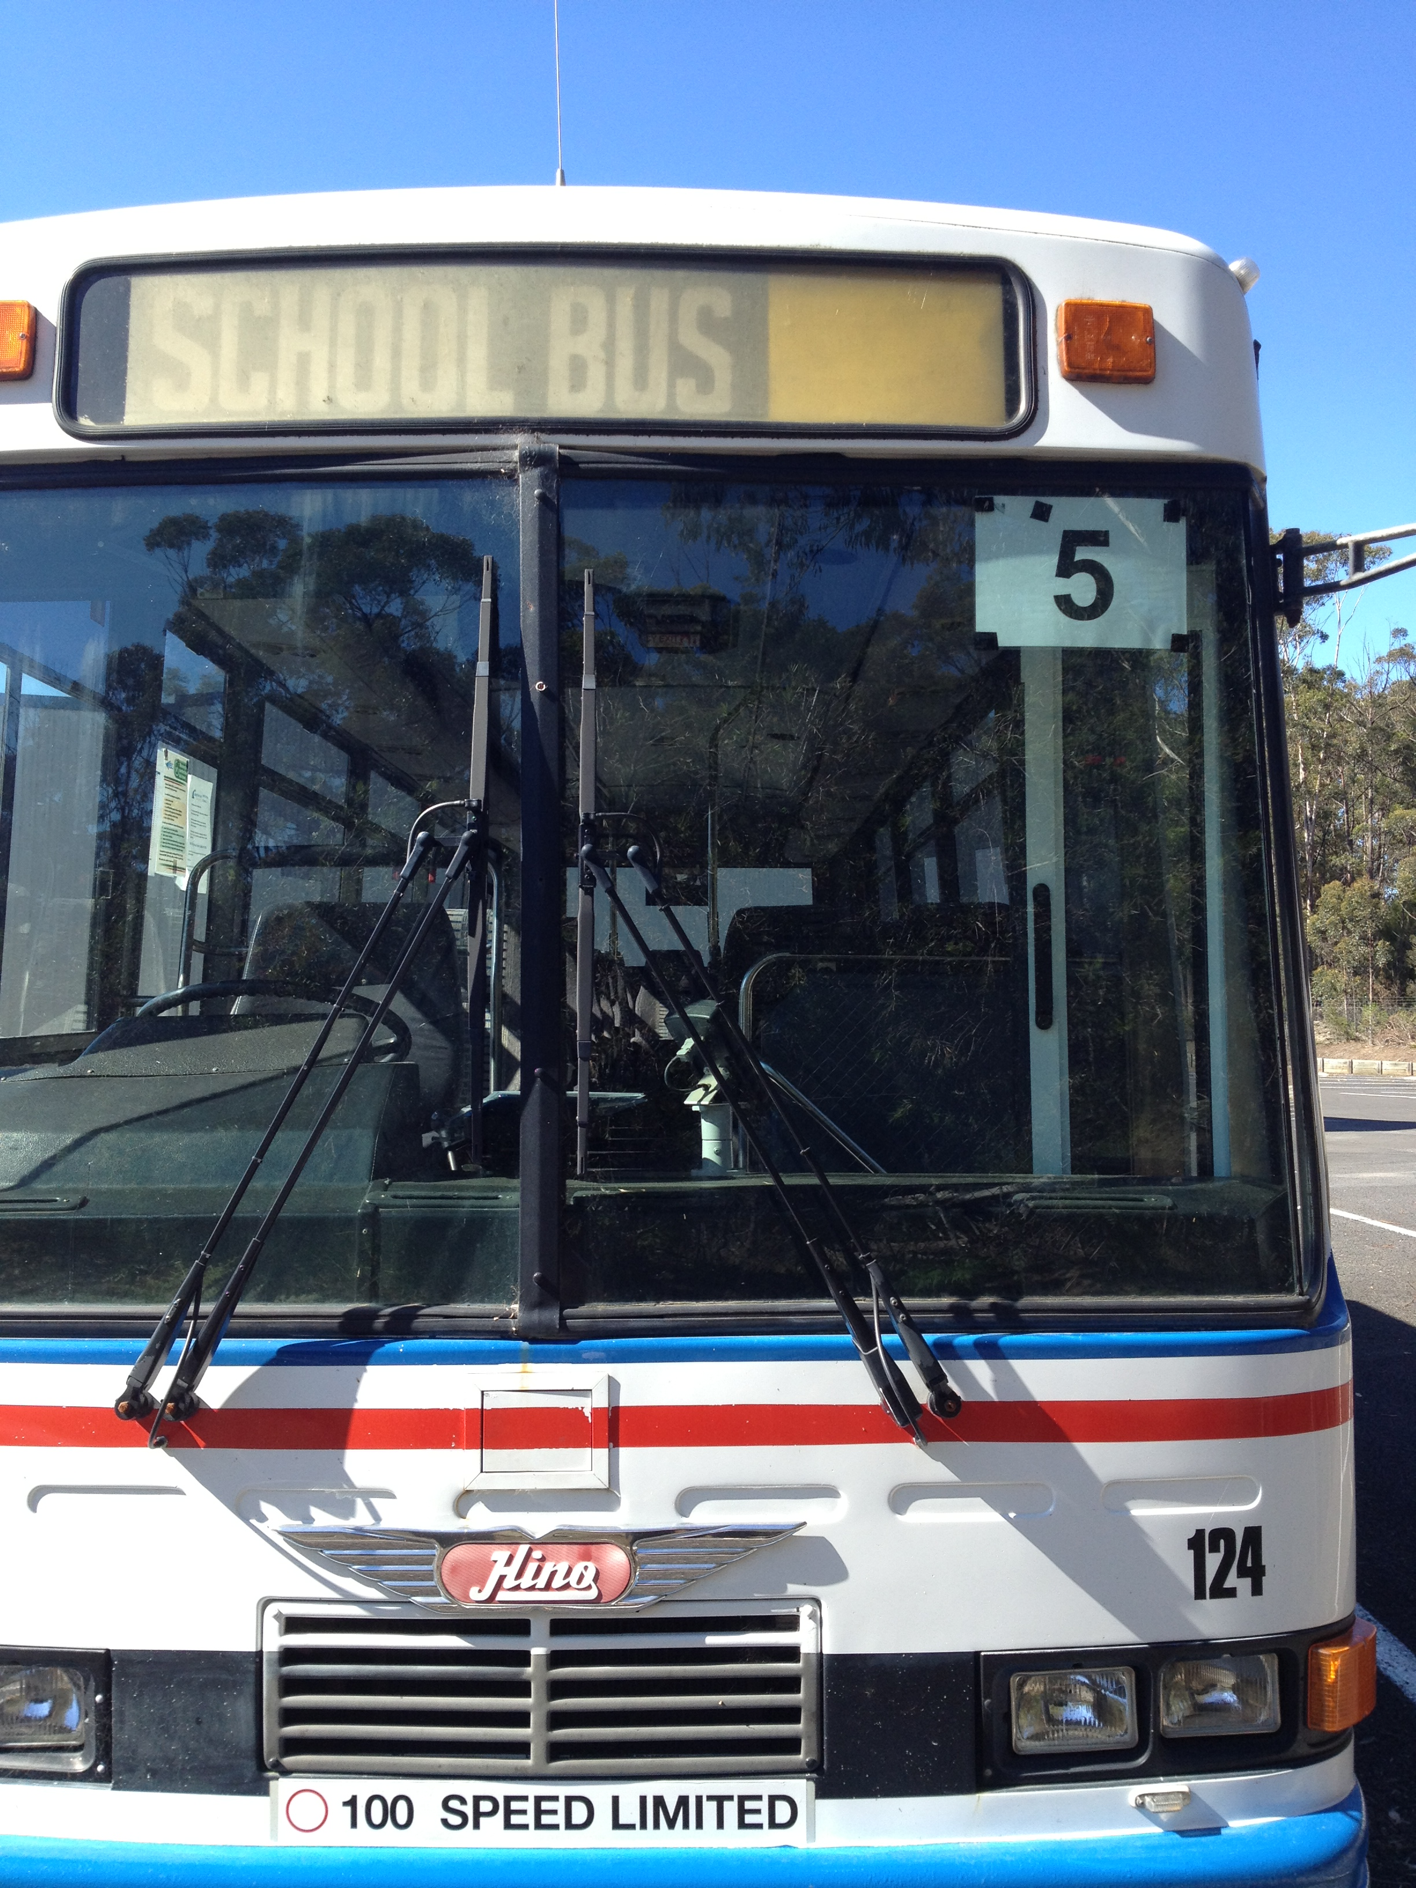
Travelling on Buses
The bus number is displayed in the front right of the bus window.
Children should wait for the bus in an orderly line at least one metre from the curb for safety.
Children should have their passes attached to their back packs or out and ready to display to the driver, both morning and afternoon.
There is no eating or drinking on the buses, except for water or for pre-discussed medical conditions.
We aim to sit primary school children at the front of the bus and secondary to the back. When embarking children should choose the closest available seat to avoid the bus taking off with children standing.

Slide 9
Frequently Asked Questions
My Child gets lost by missing their stop or getting on the wrong bus?
  We have constant radio contact with all our drivers, the passes help us to identify students and between the drivers, our operations team and the school we will work with you to locate the child and have them returned to you safely.
My child is sick on the bus or has a medical condition or disability?
  It is helpful to us if we are informed of your child's condition or special requirements so that we can be aware of assistance we may need to provide. This can be printed on their pass if you wish. Our drivers all have basic training in how to deal with passengers with special needs or requirements.
Why do the children have to show their passes every day?
  This assists the driver to know they are on the correct bus, and to know where they should embark and disembark the bus. It is a requirement of the driver to check every day – it is their job!
Notes:
The child showing their pass is a form of identification that lets the driver know they are on the correct bus.

Slide 10
Lost property and broken passes
We have a very stringent lost property policy within the company. All found property is returned to the office, processed and kept on site for three months therefore if your child looses something please call and report it.
We have had some trouble over the past few years with passes breaking. We have a benefit of the doubt policy for the first pass if it has not been obviously broken, however subsequent replacement passes due to being broken will cost $15.00, all lost passes will cost $15.00 to replace.

Slide 11
Term Passes or alternate routes of travel
School Free Travel is provided to children by the state government is for the purpose of travel from Home to School
If for some reason your child needs to travel on a different bus or a further distance for work, after school care or sport for example we have term passes for purchase at a cost of $50.00 per term
Yearly passes are discounted by 10%

Slide 12


Travel in the school holidays
During the school holidays your child's bus pass is not permitted to be used for travel, we have therefore partnered with many local business to present you with the Happy Holiday Pass initiative.
For $25.00 this pass allows unlimited bus travel during the school holidays plus a range of discounts at local businesses.

Slide 13

Notes:
Does anyone have any Questions?

